Slide 1
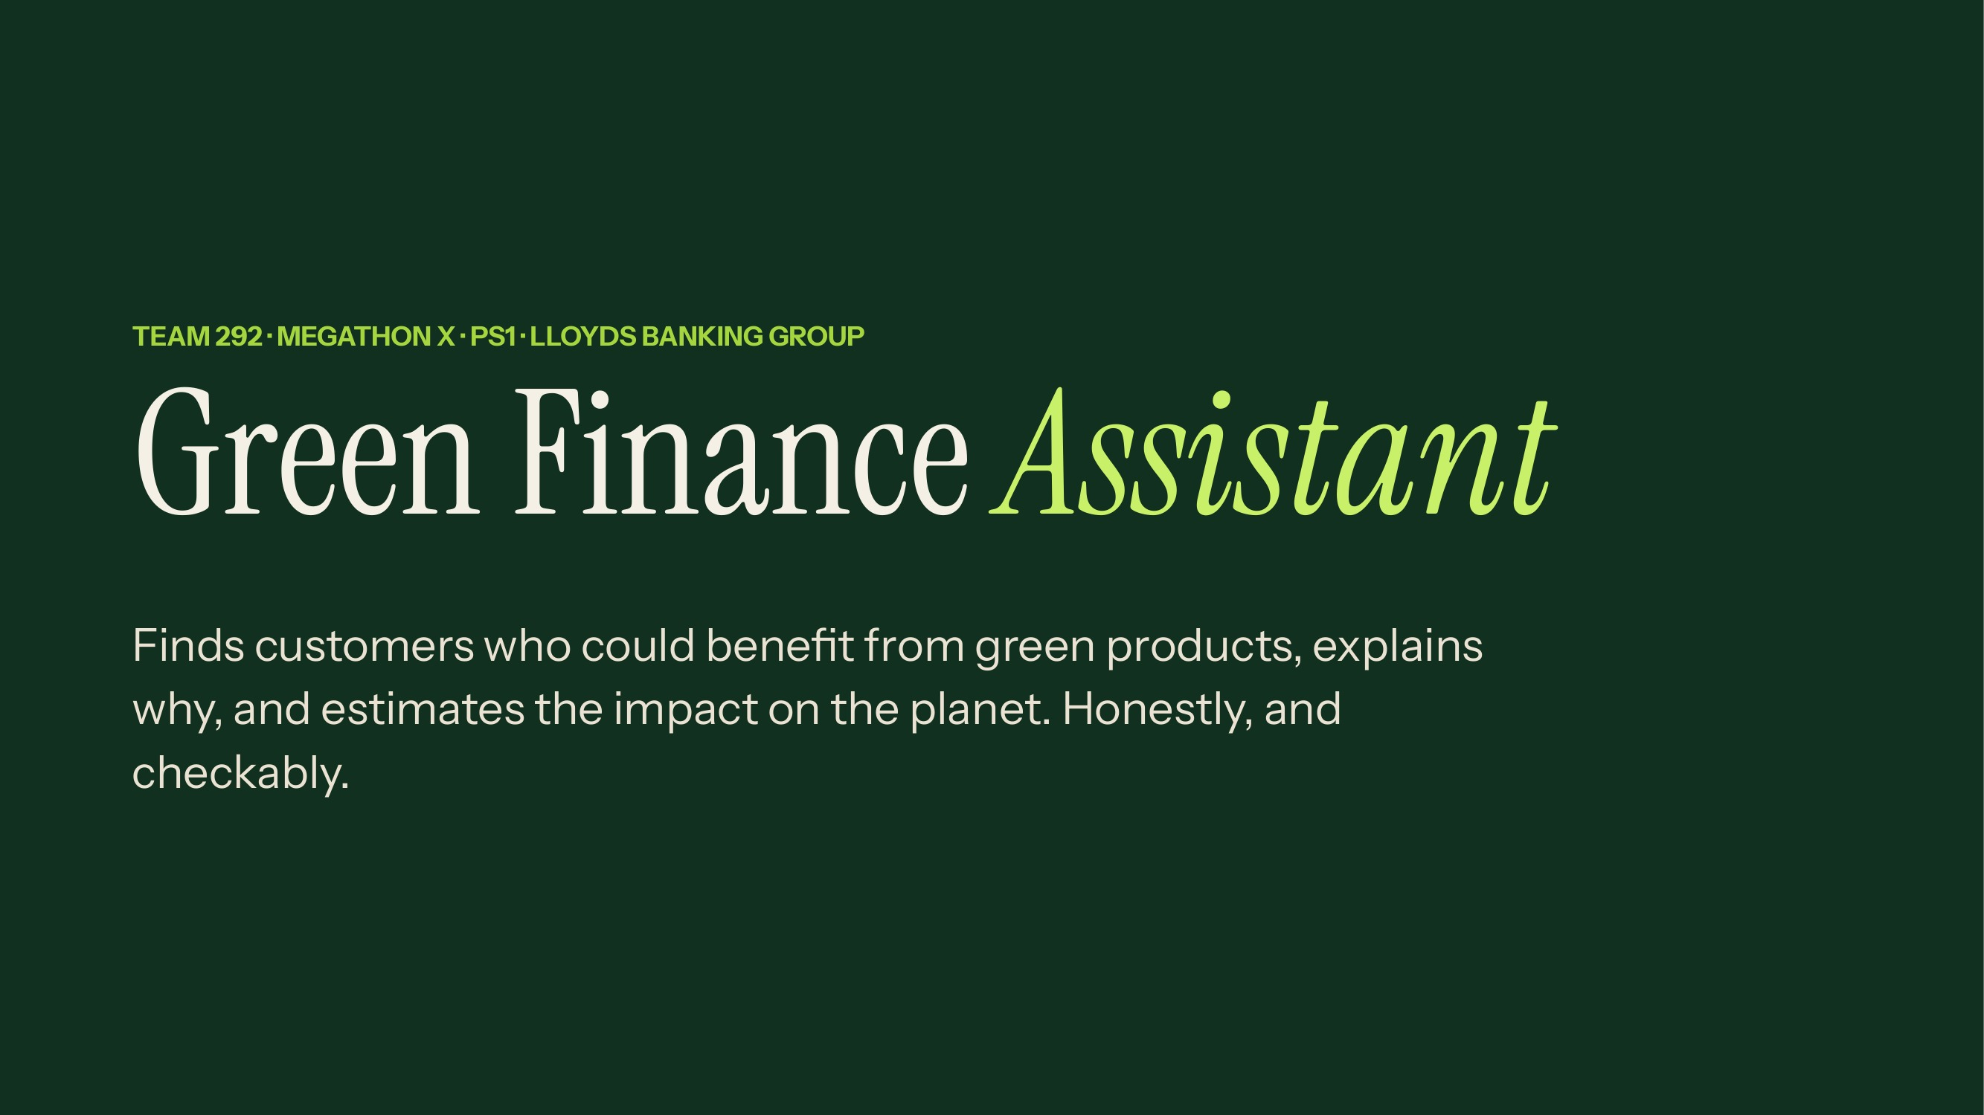
Notes:
30-second pitch: Banks can see how customers spend on petrol, electricity and paper. We turn that into green product suggestions. The key idea is trust: every suggestion shows its reasons, a separate rule check decides who is eligible, a fixed calculator estimates the carbon saved, and the AI only writes up results it is given. Nothing is guessed or invented.

Slide 2
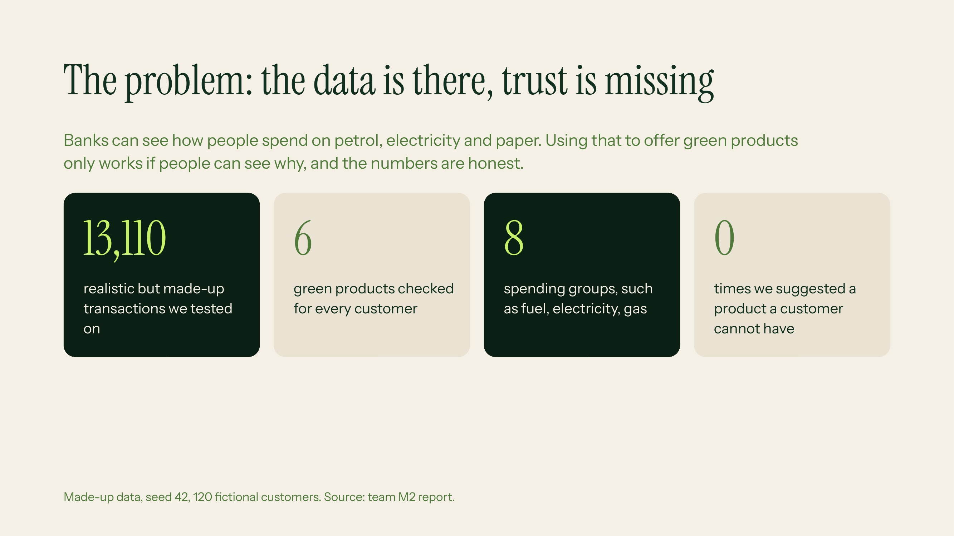
Notes:
Explain: our problem is not finding patterns, it is being trustworthy. Say that the numbers on screen are from our own test run on made-up data, not real customers. Likely question: why synthetic data? Answer: the challenge forbids real banking data, and a fixed seed lets judges recreate it exactly.

Slide 3
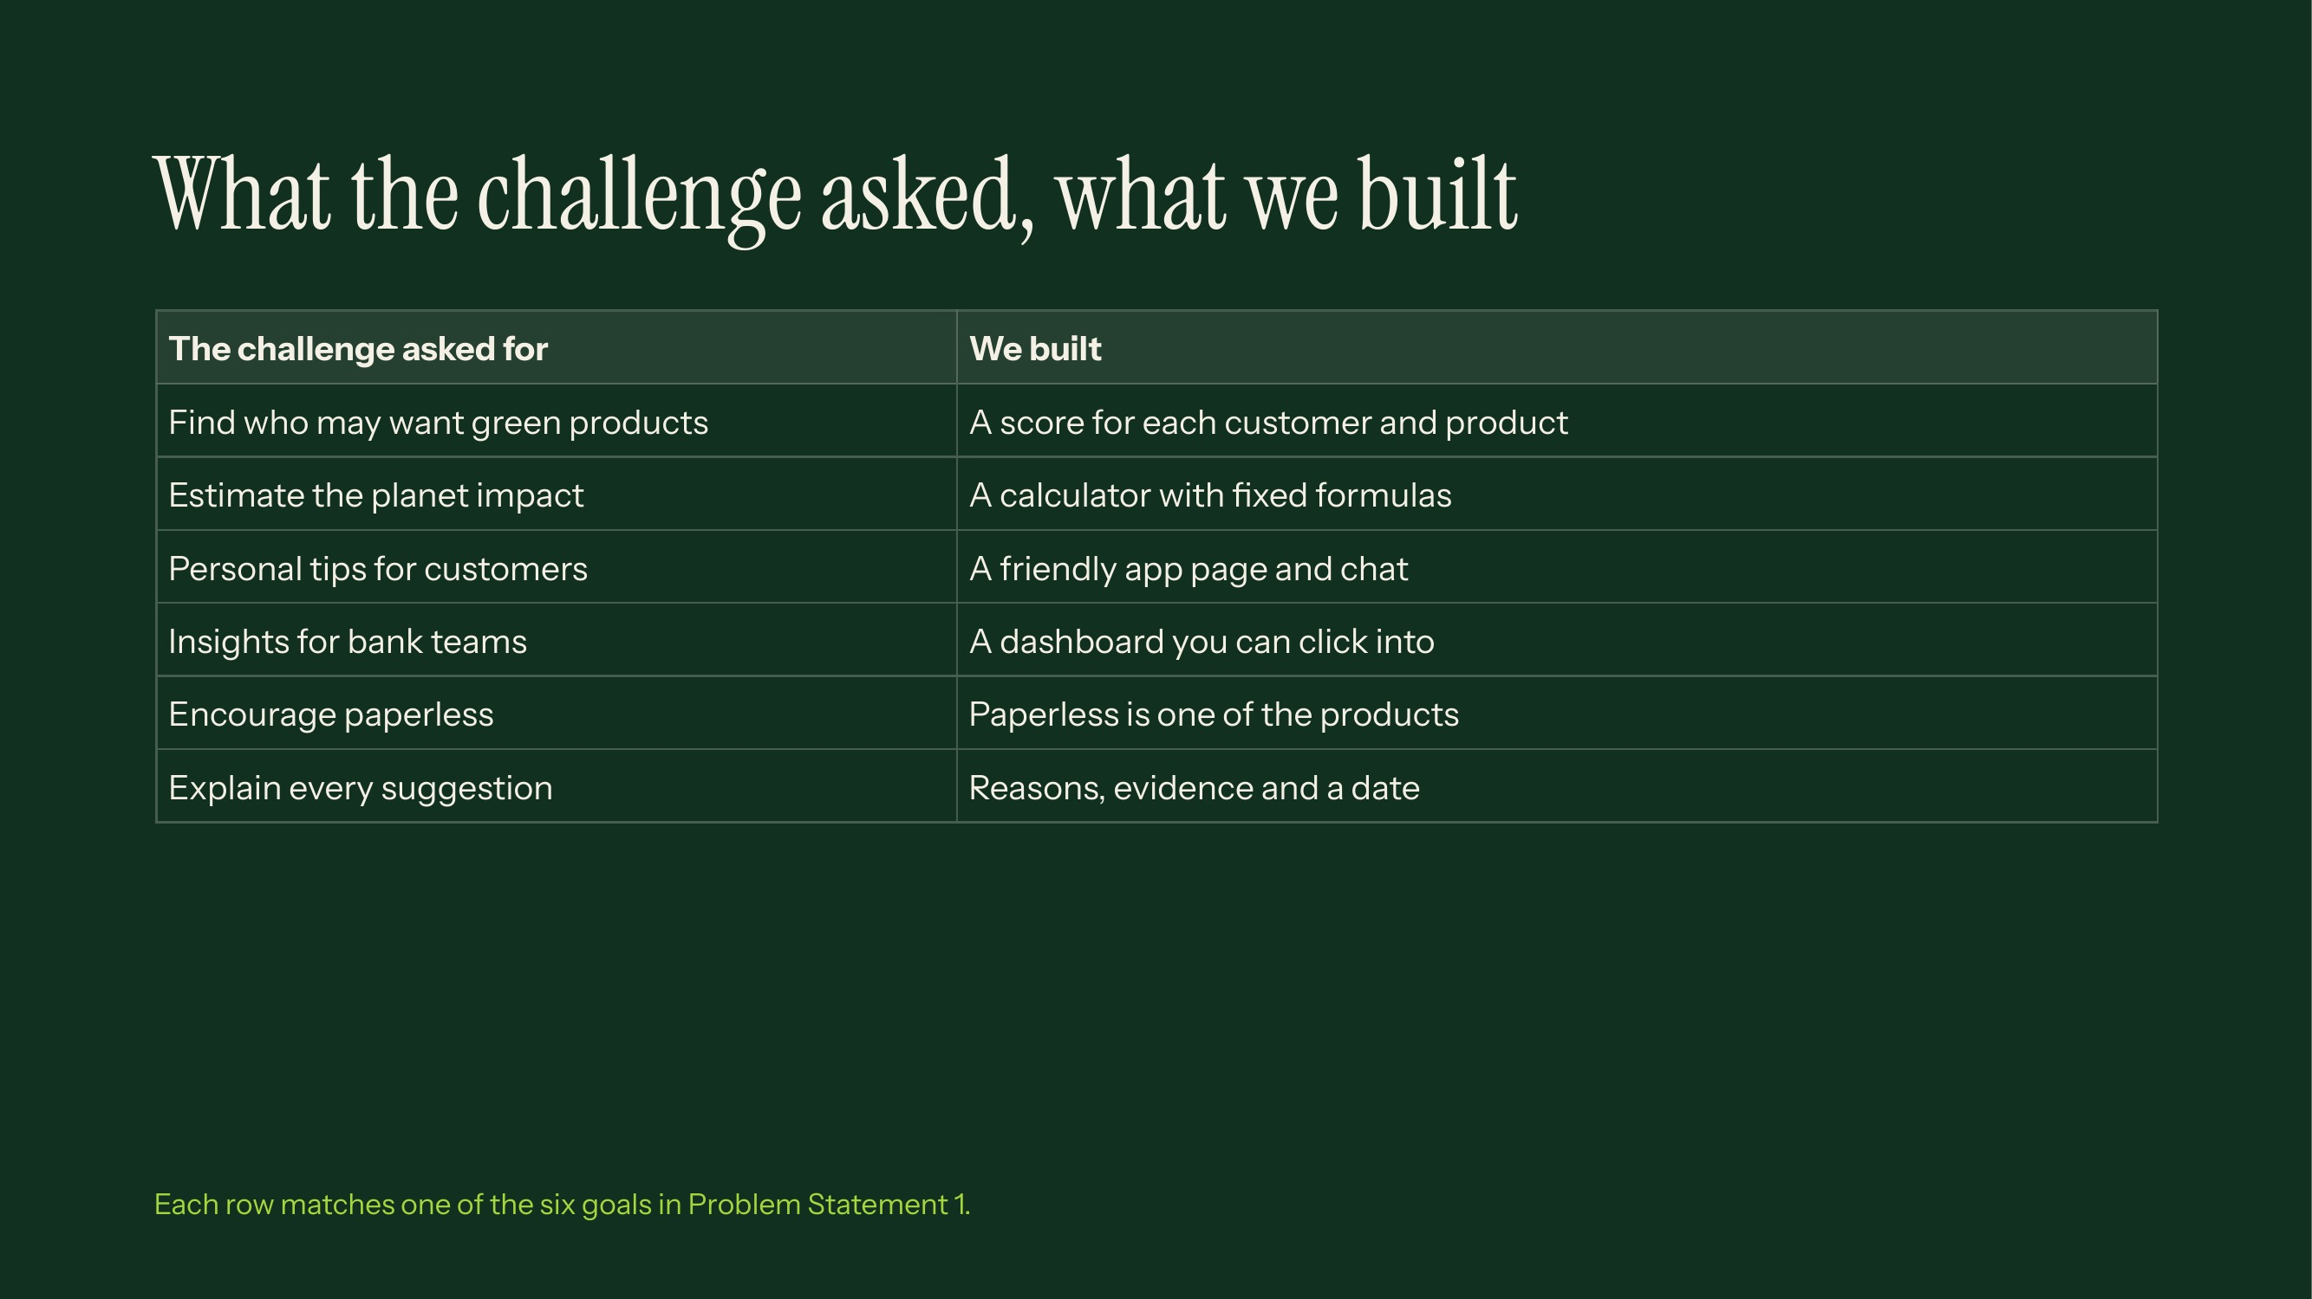
Notes:
Walk down the table left to right. This slide shows judges we covered every requirement. Mention the four required products are EV Finance, Green Home Loan, Solar Finance and Paperless Banking, and we also added two optional ones: Green Investments and Green Loans.

Slide 4
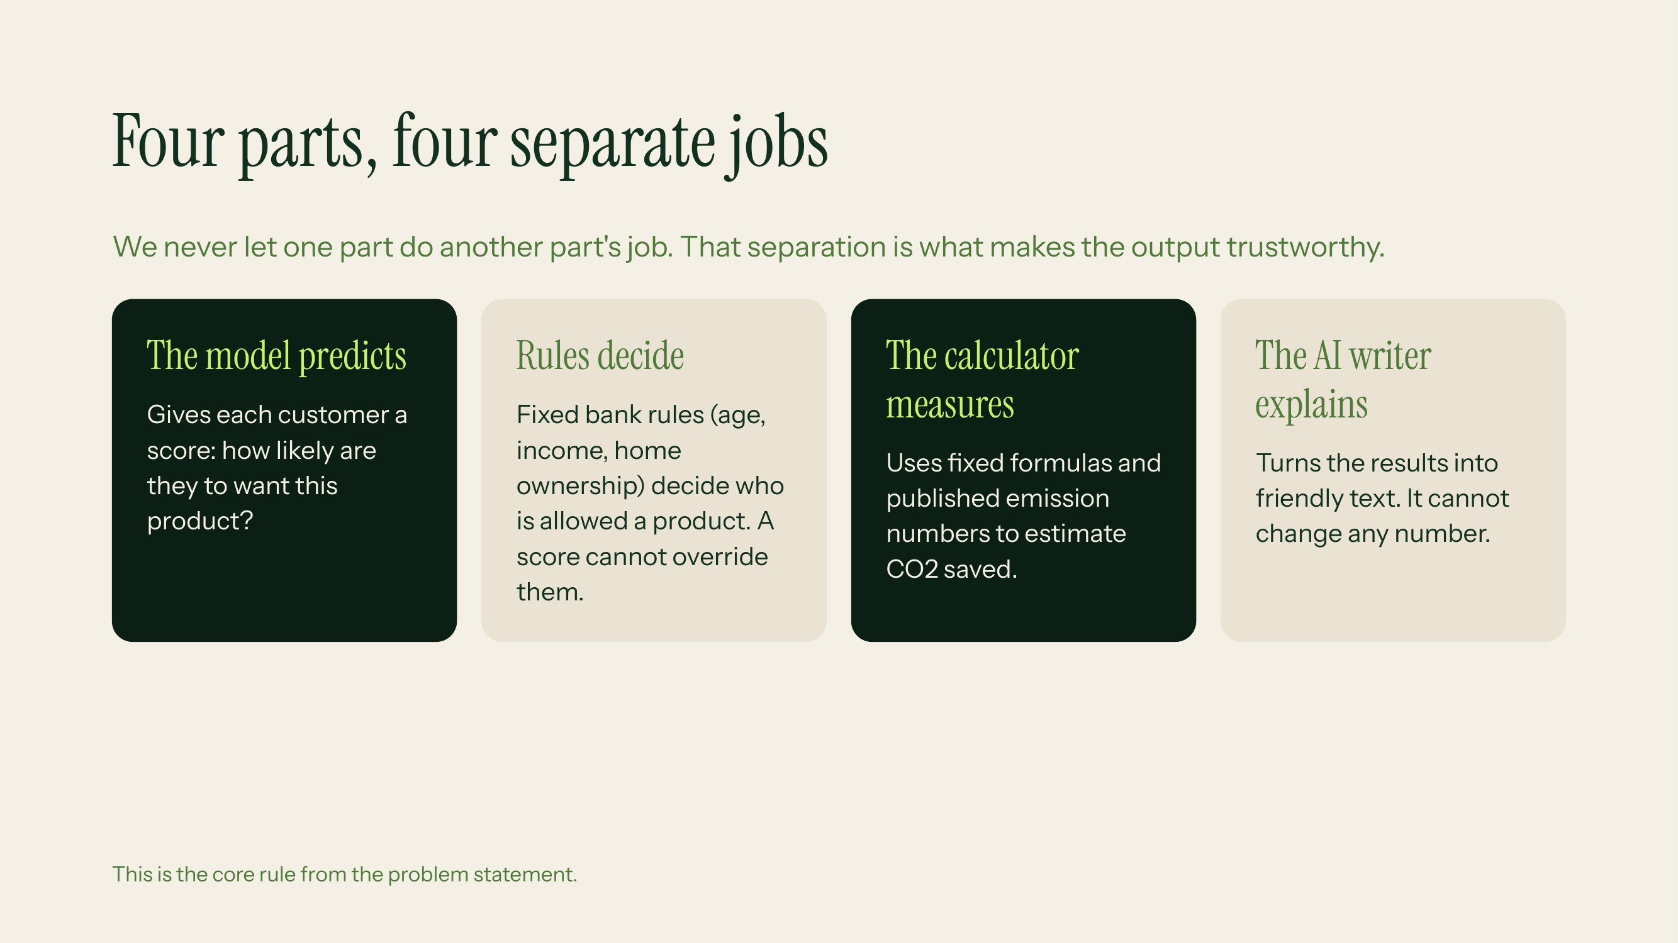
Notes:
This is the most important slide to explain. Use an analogy: a model is like a weather forecast, rules are like the law, the calculator is like a ruler, and the AI writer is like a news presenter reading the facts. Likely question: why not let the AI do everything? Answer: AI can sound confident and be wrong, so numbers and eligibility come from code we can test.

Slide 5
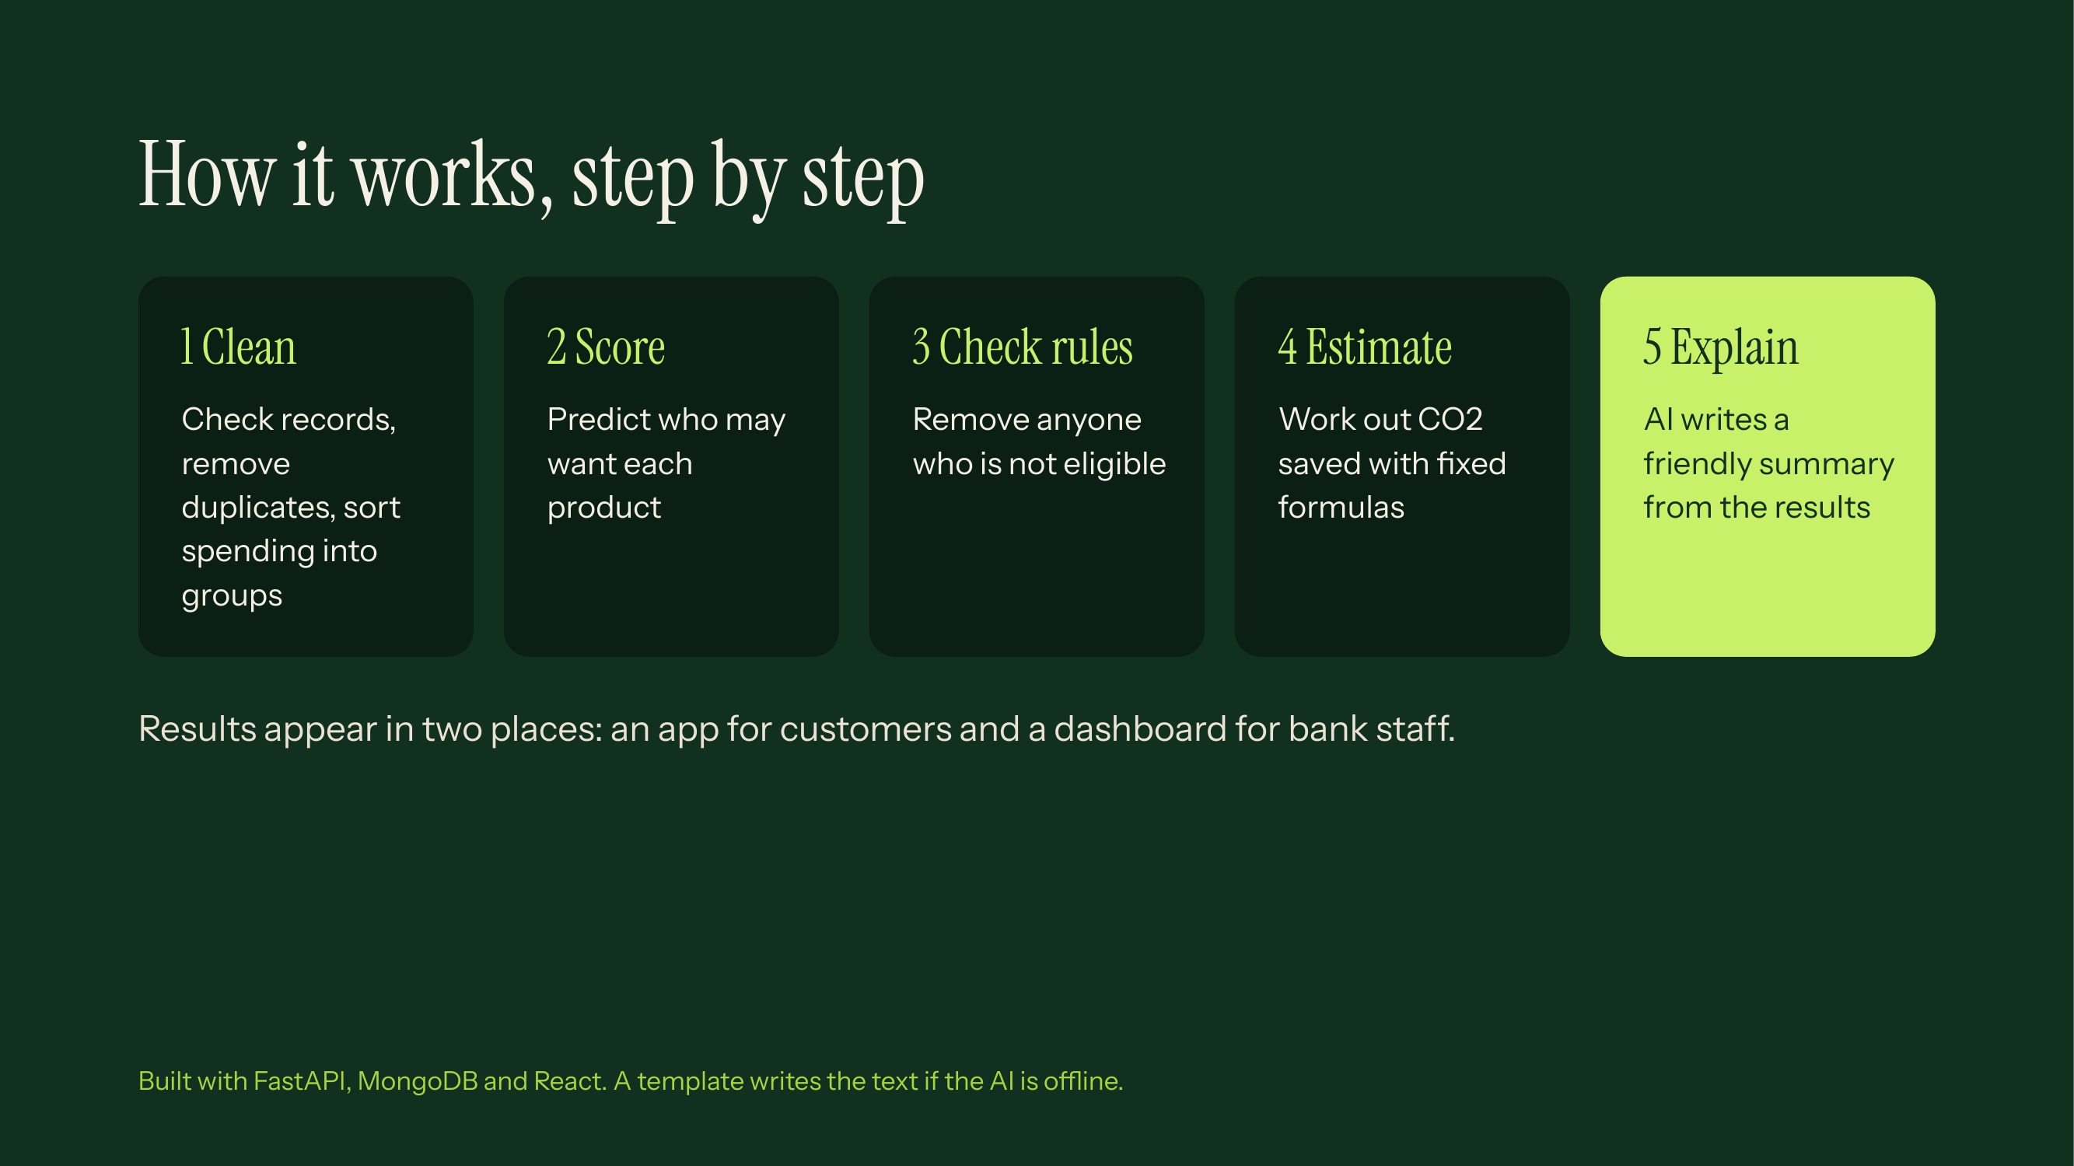
Notes:
Follow one customer through the five steps: their payments are cleaned and grouped, we score their interest, we check the rules, we estimate the carbon saved, and finally the AI turns it into a sentence they can read. Technical note for judges: backend is FastAPI with MongoDB, frontend is React.

Slide 6
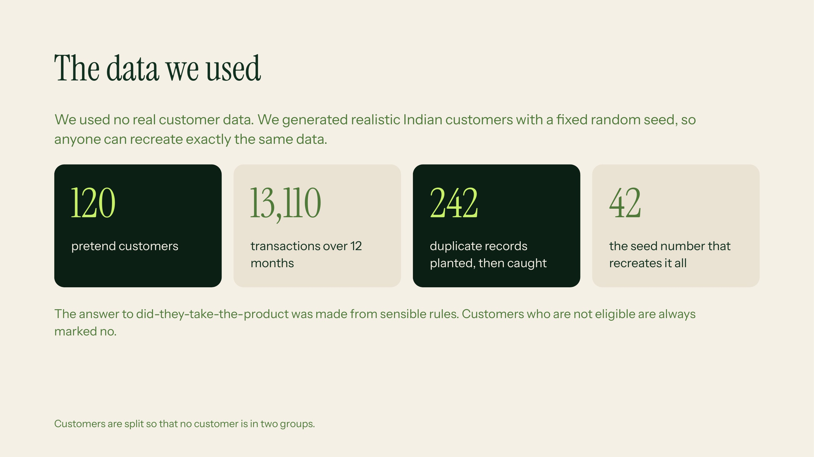
Notes:
Explain that we planted duplicates on purpose to prove our data checks work, and that all 242 were flagged and removed. Explain the labels: since there is no real history, we created a documented rule for who takes up a product, based on their spending, with some randomness added. Be upfront that this makes results provisional.

Slide 7
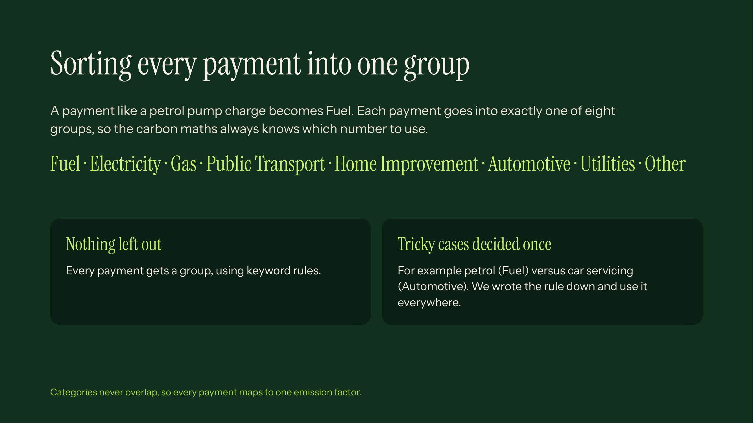
Notes:
The challenge fixed these eight categories. We use keyword rules, which are simple and explainable. The same rules also handle a CSV a judge uploads. If asked about the Other group: it catches anything we cannot place, instead of forcing a wrong label.

Slide 8
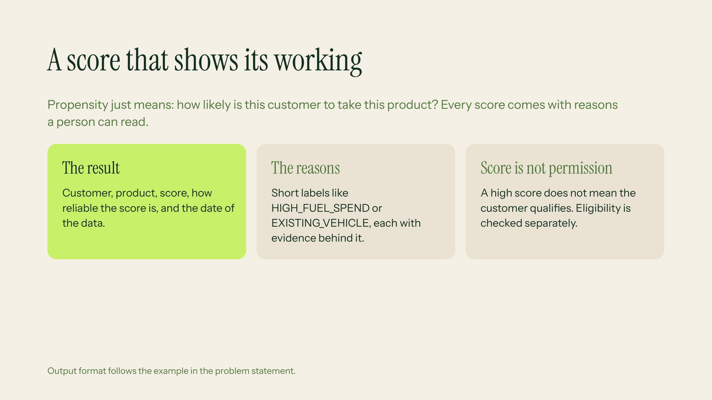
Notes:
Explain that confidence is separate from the score: the score says how likely, confidence says how much to trust it. Our model is a transparent weighted score, not a black box, so each reason is simply one of the ingredients and its weight. Likely question: why not a deep model? Answer: with 120 customers a simple model is more honest and fully explainable.

Slide 9
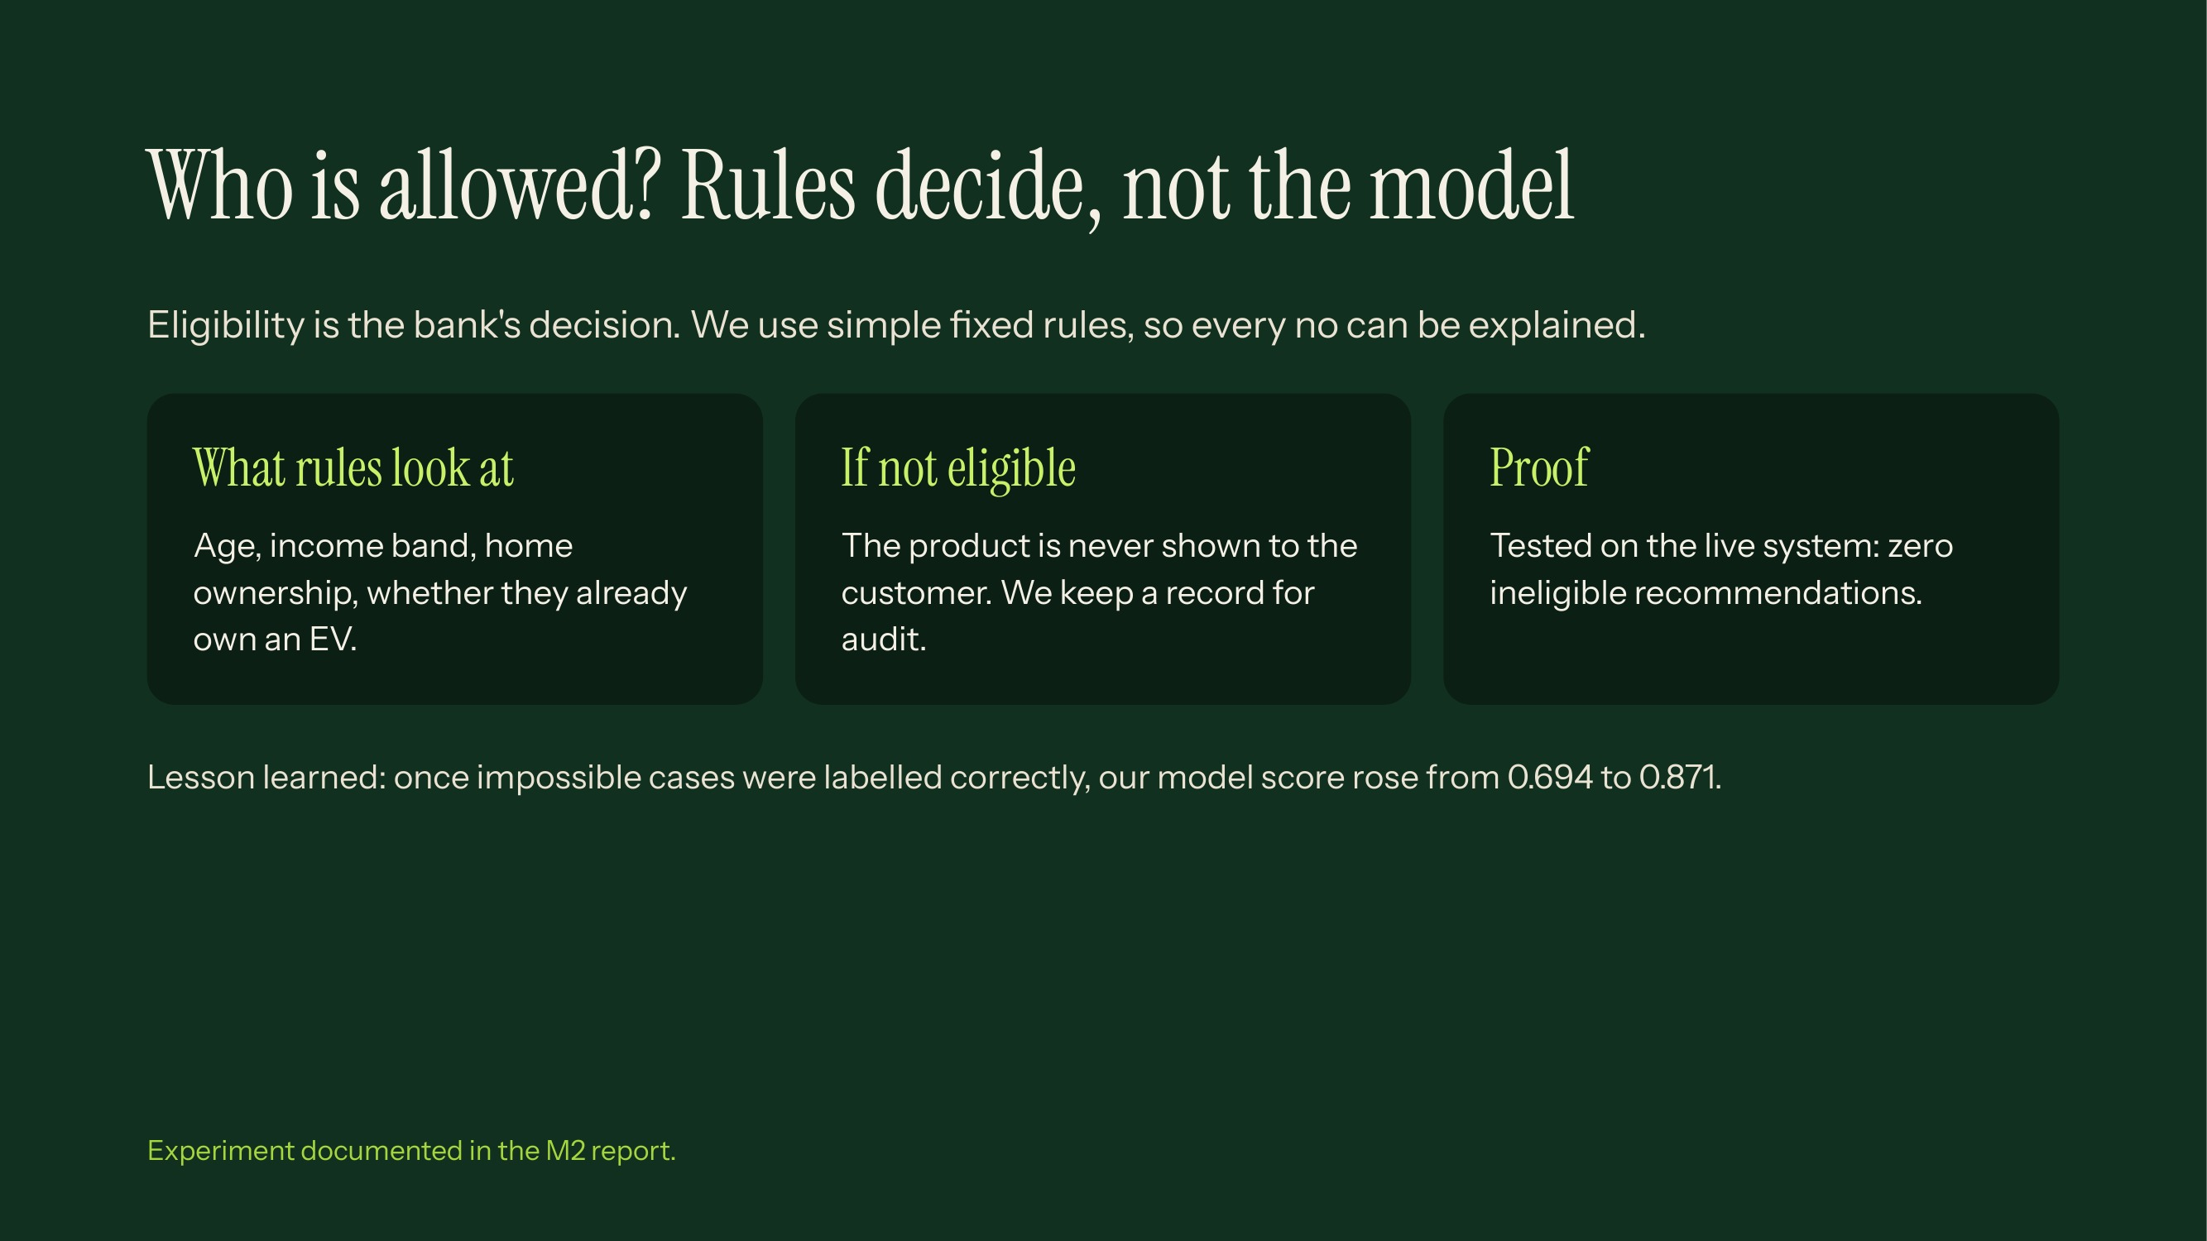
Notes:
Example: if a customer already owns an EV, we do not suggest EV finance, however high the score. The 0.694 to 0.871 figure is the model accuracy score called AUC (explained on the results slide). It rose because we stopped labelling ineligible customers as having taken the product, which is impossible in real life.

Slide 10
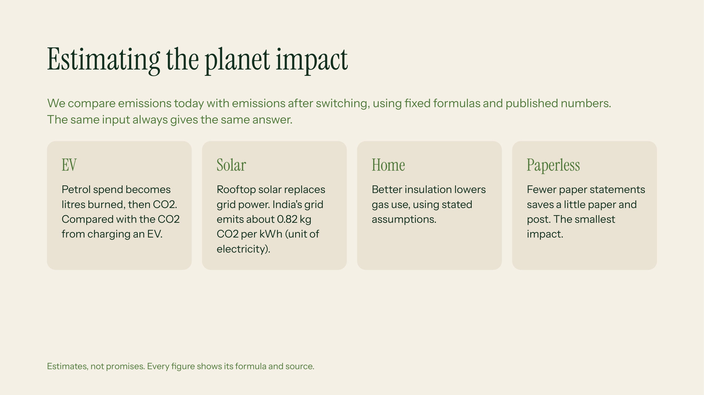
Notes:
CO2e means carbon dioxide equivalent, a single unit for all greenhouse gases. Sources: CEA India for the grid, IPCC for fuels, DEFRA 2023 for paper. We passed 4 of 4 known-answer tests and 11 of 11 public test cases exactly. Say clearly: real savings depend on how the customer behaves, so we call these estimates.

Slide 11
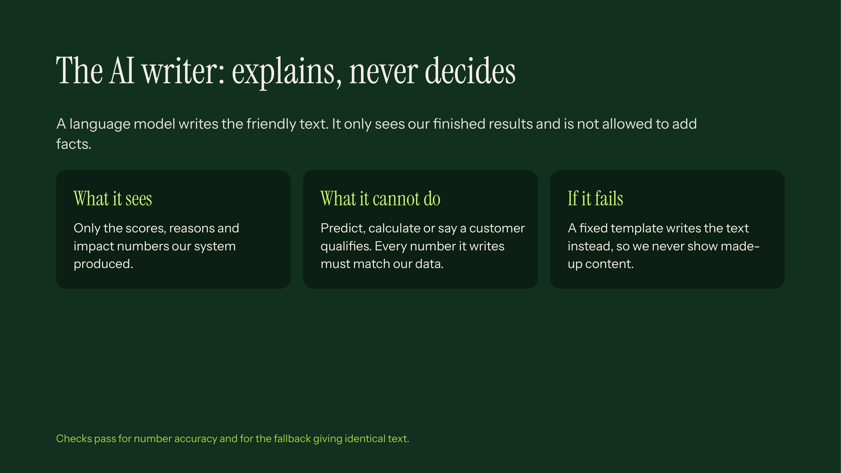
Notes:
Hallucination means an AI inventing facts. We prevent it by giving the AI only structured results and checking that every number in its text exists in our data. If the AI is down, a template produces the same facts in plain wording, so the product still works.

Slide 12
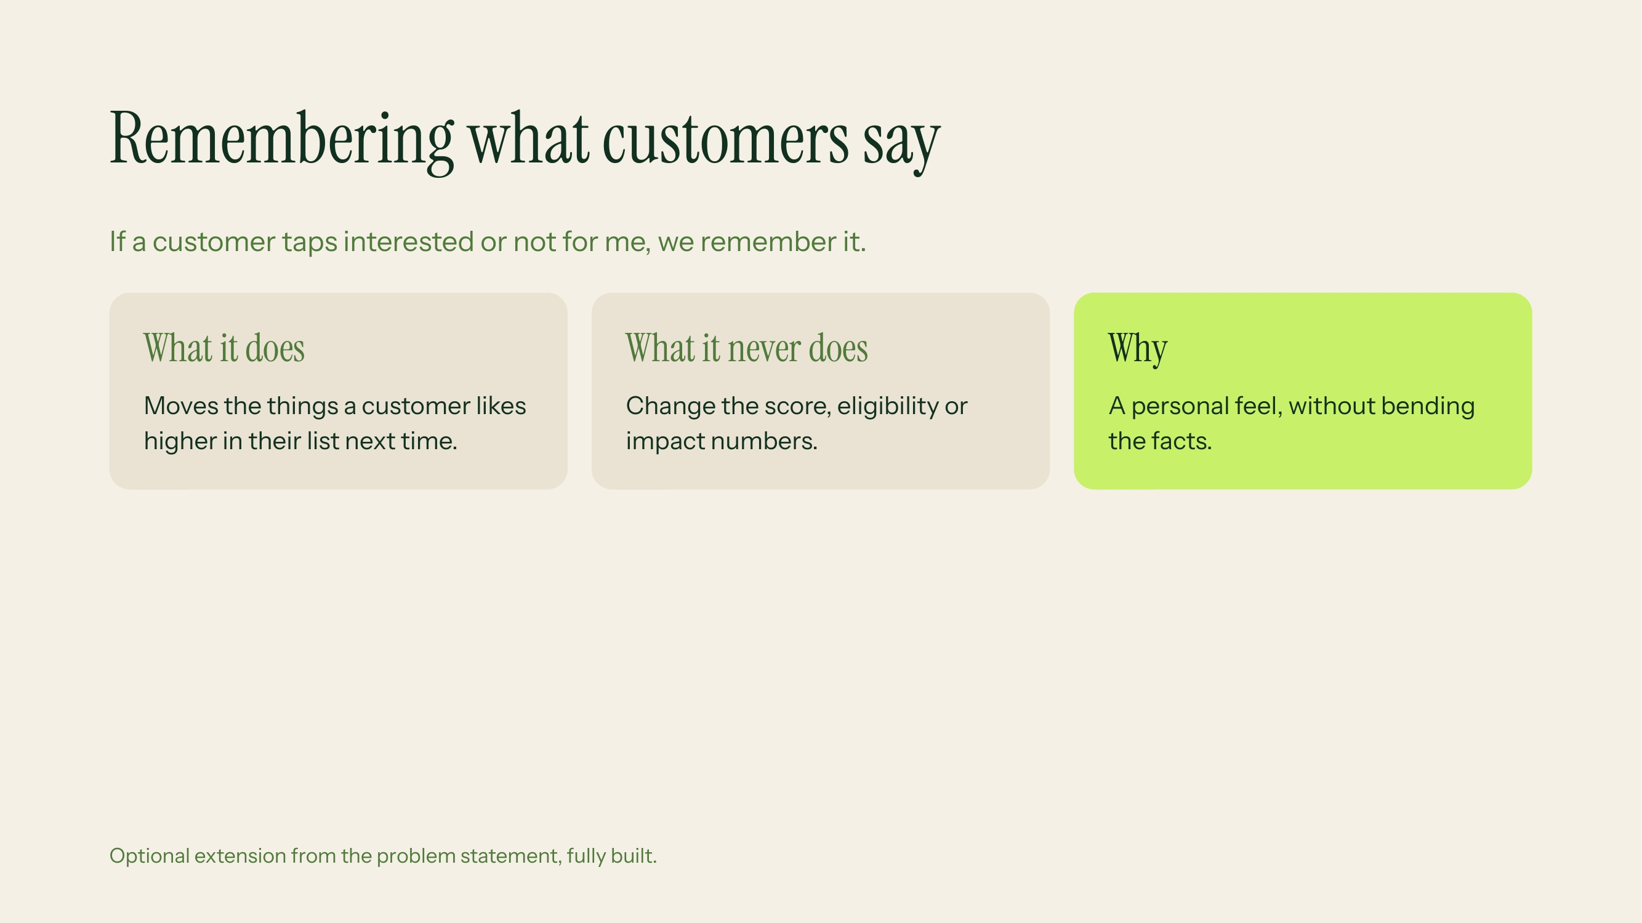
Notes:
This is our optional extension. Show how it works: a customer taps not for me on EV finance and it drops down their list. But the underlying score and eligibility do not change, which keeps the system honest.

Slide 13
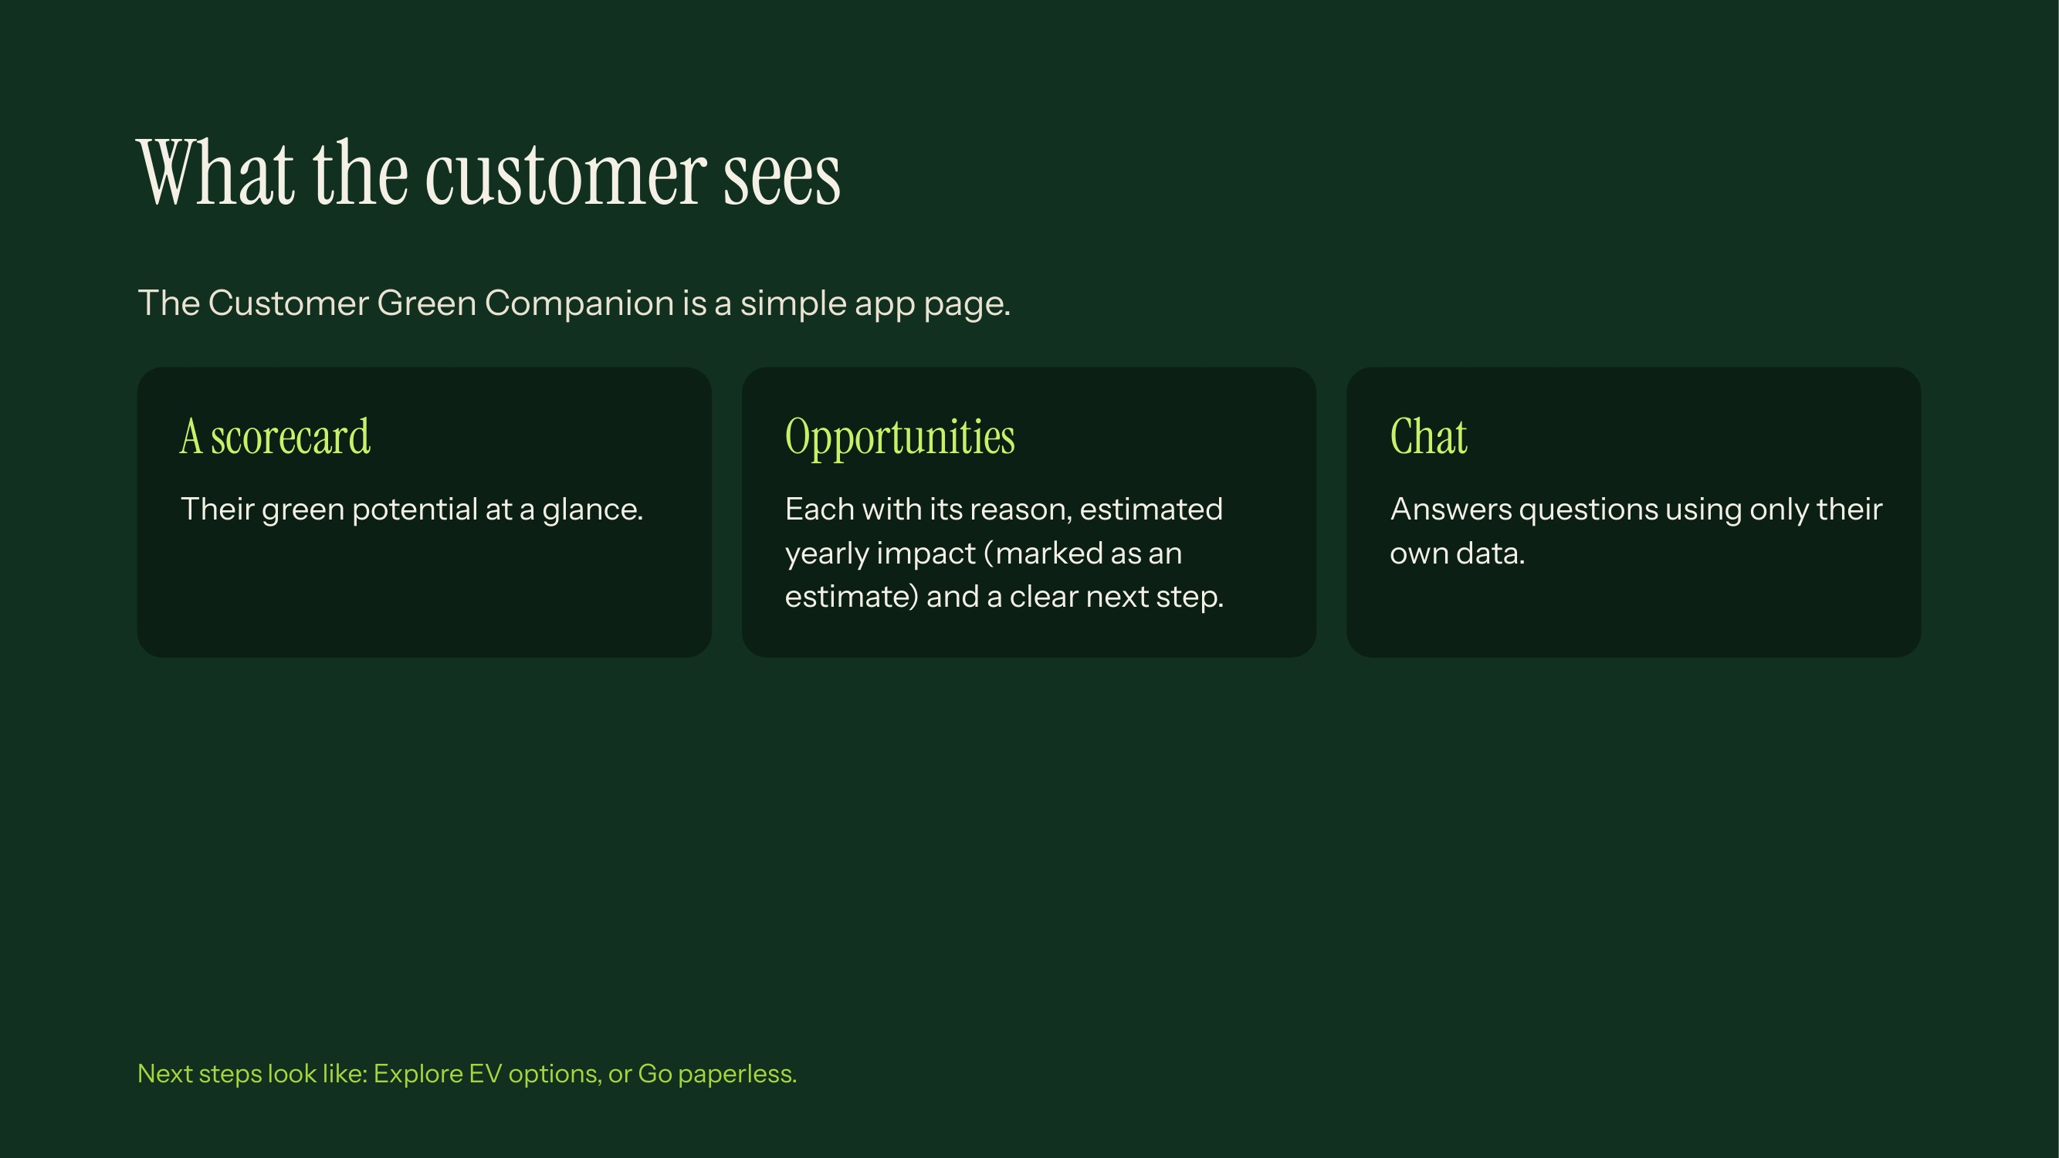
Notes:
Do a live demo here if possible. Show one opportunity, point to the reason, the estimate label and the action button. Stress that the chat cannot answer from general knowledge, only from the customer's own structured data.

Slide 14
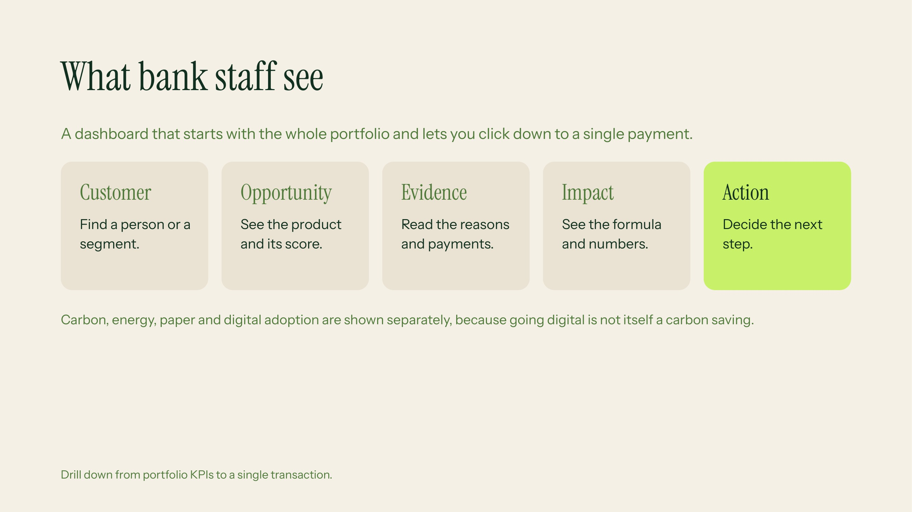
Notes:
This is for relationship managers. Business value: they can see which customer groups have the most potential and open any number to see exactly where it came from. The separate reporting of digital adoption is a requirement from the problem statement.

Slide 15
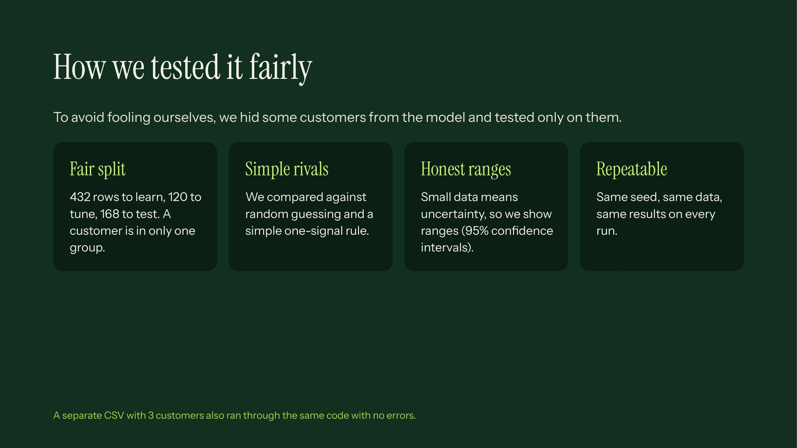
Notes:
A row means one customer and product pair. Data leakage is when test information sneaks into training, which makes results look better than they are. We prevent it by splitting by customer. A baseline is a simple rival we must beat to justify the complexity. Offer judges the verification page to rerun everything live.

Slide 16
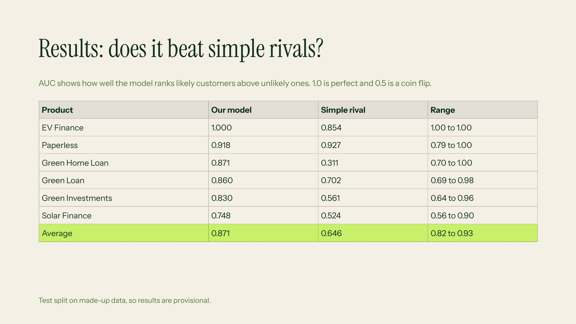
Notes:
Headline: we beat the simple rival on 5 of 6 products and on average, 0.871 against 0.646. Be honest about two things: Paperless is a near tie because digital activity alone almost tells you the answer, and Solar is weakest with a wide range because there are few positive examples. Judges like honesty here. EV scoring 1.000 reflects the clean synthetic data, so do not oversell it.

Slide 17
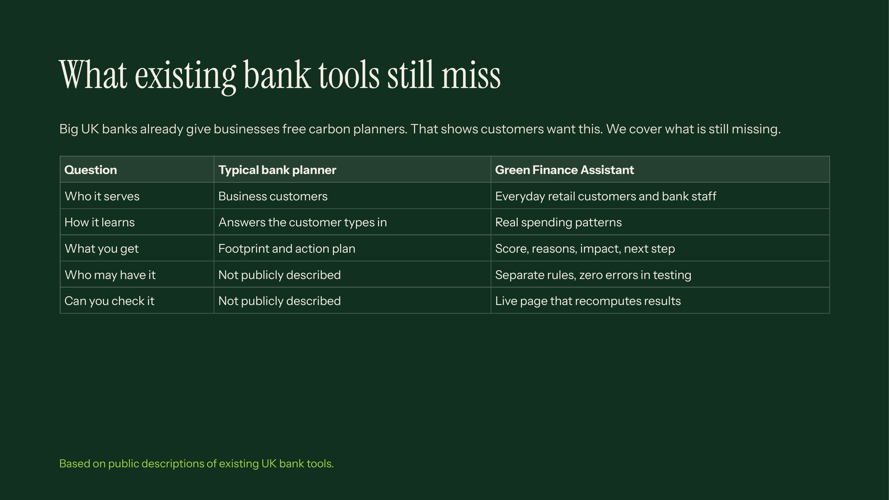
Notes:
Do not name competitors on the slide. If a judge asks, say the leading UK high street rival launched a free questionnaire-based carbon planner for businesses in 2022 and thousands of businesses used it in year one. That is good: it proves demand. Our difference: we start from real spending instead of questionnaires, serve retail customers, keep eligibility separate, and let anyone verify our numbers. Be fair: they have real scale and we are a prototype.

Slide 18
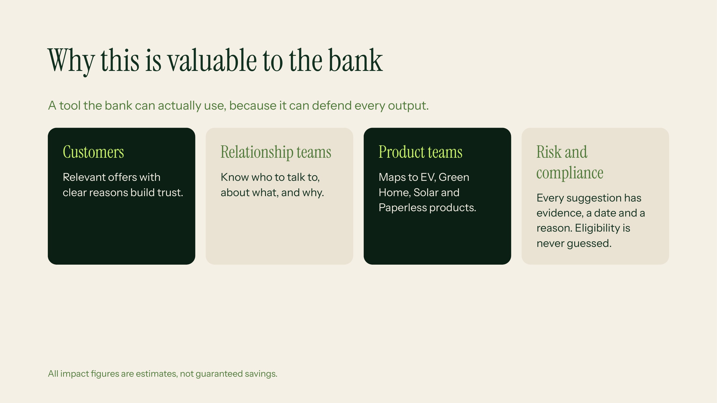
Notes:
Connect to Lloyds goals: more relevant product conversations, support for customers moving to low-carbon options, and a design that compliance teams can audit. Avoid inventing revenue numbers, we have not measured conversion. Say that a pilot with real consented data would be the next step.

Slide 19
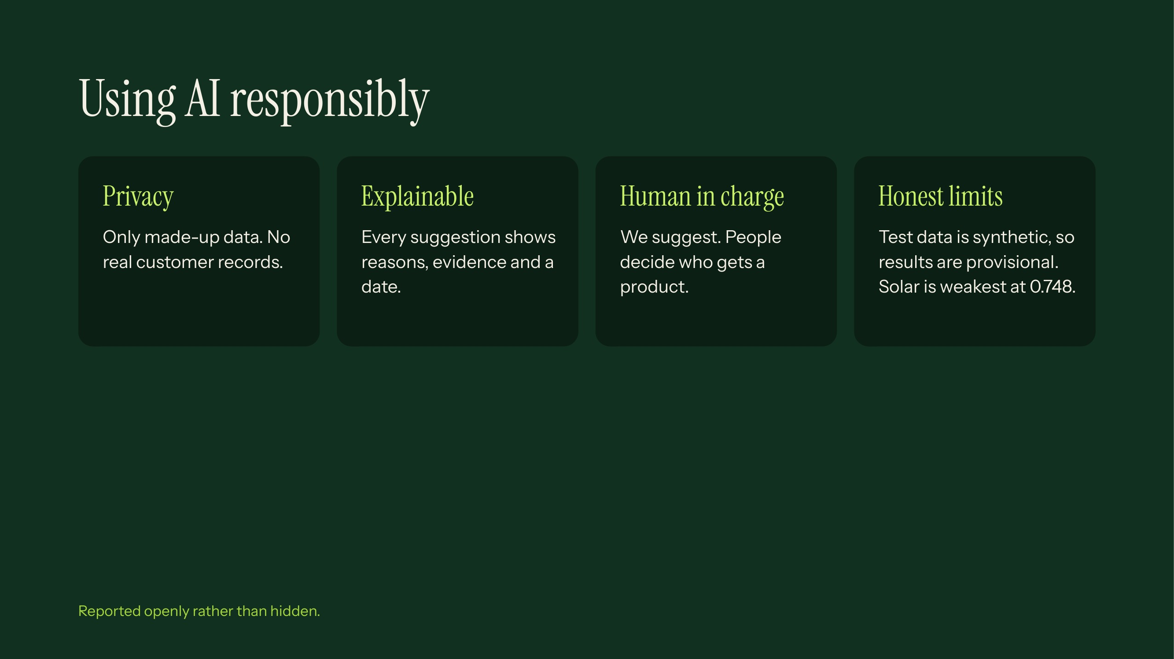
Notes:
This covers privacy, bias, explainability, hallucination, human oversight and data limits as the challenge requires. Admit limits: small data set, synthetic labels, estimates rather than guaranteed savings. Next steps: test with real consented data and check fairness across customer groups.

Slide 20
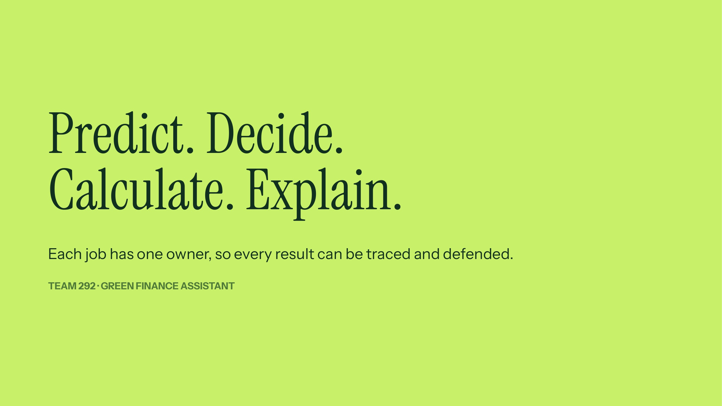
Notes:
Close by repeating the four words: the model predicts, rules decide, the calculator measures, the AI explains. Invite judges to try the verification page and ask questions.

Slide 21
